Slide 1
PRE-MASTER SUMMER COURSE IN STATISTICS
Riccardo Fanciulli, Andrea Haker, Tom van Engers, Natasa Brower-Zupancic, Andre Heck, Max Cohen

Slide 2
Points of the talk
Why the need for a statistics pre-master course
Aim of the course
Structure of the course
Current design
Other design ideas
The platform used: SOWISOTM
Diagnostic test
Topical tests
Final test
Issues and ideas

Slide 3
Why the need for the e-course?
On paper the students starting the FS master program all have had some courses in statistics.
However it was observed by some instructors that the need to review basic statistical concepts was taking precious time away from the covering of more advanced concepts.

Slide 4
Aim of the course
The aim of the online course is twofold:
Help give a statistics kick-start to the incoming students. Provide a non-confrontational environment where they can check their knowledge and fill any gaps they might have.
Serve as a tool for all FS instructors who may refer their students to one or the other topic as needed when needed.

Slide 5
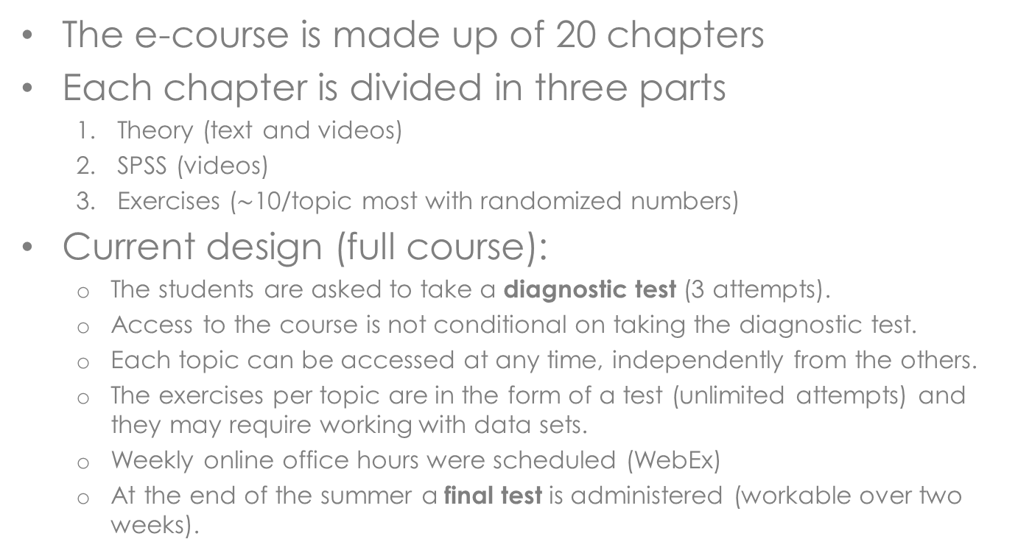
Structure of the summer course: current design
The e-course is made up of 20 chapters
Each chapter is divided in three parts
Theory (text and videos)
SPSS (videos)
Exercises ($\sim$10/topic most with randomized numbers)
Current design (full course):
The students are asked to take a diagnostic test (3 attempts).
Access to the course is not conditional on taking the diagnostic test.
Each topic can be accessed at any time, independently from the others.
The exercises per topic are in the form of a test (unlimited attempts) and they may require working with data sets.
Weekly online office hours were scheduled (WebEx)
At the end of the summer a final test is administered (workable over two weeks).

Slide 6
Structure of the summer course: alternative designs
Alternative design I
The students need to take a diagnostic test before accessing the material.
Each topic can be accessed at any time, independently from the others.
A few un-graded exercises are available per topic
The topical tests assume more importance:
The final test can be accessed only if a minimum threshold is reached in each test.
The final test is workable in a period of two weeks, but can be worked on only for a limited time (2 hrs..)
Alternative design II
Same as the I, but the final is accessible only as soon as a minimum average in the topical tests is reached.
More alternative designs
….. We gladly hear your input!

Slide 7
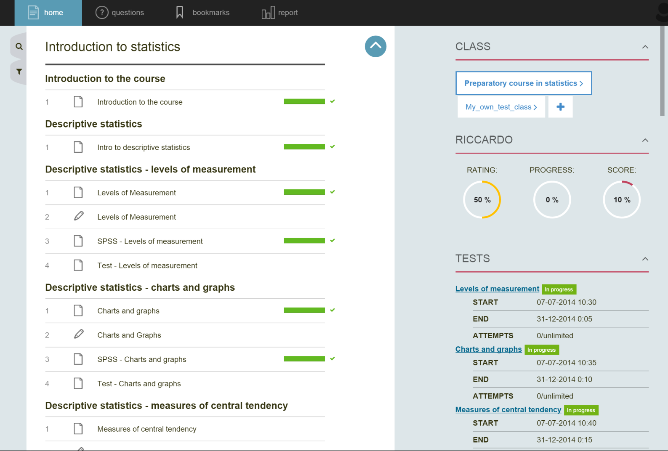
The platform used: SOWISOTM
A new platform designed for online-teaching of scientific topics was used.

Slide 8
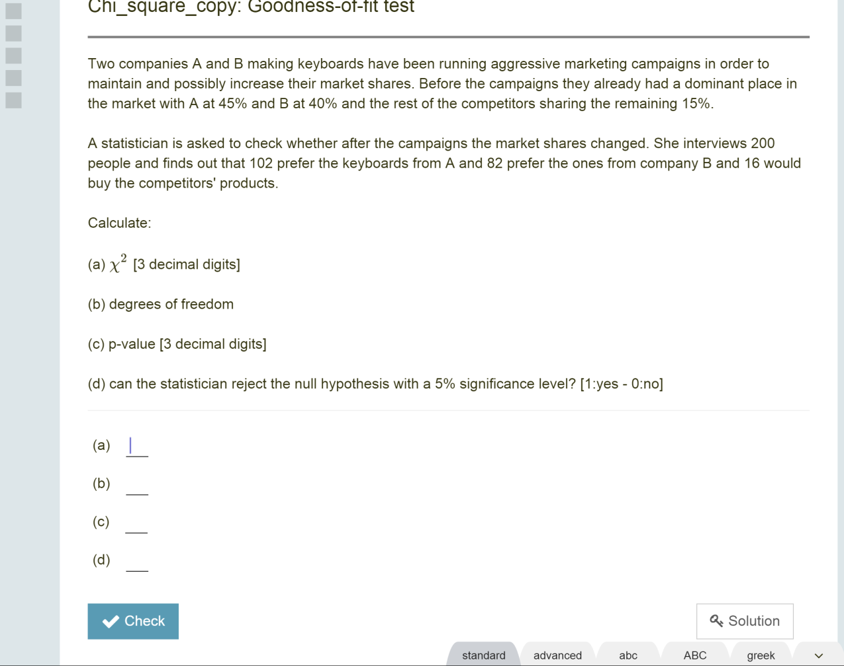
The platform used: SOWISOTM
Testing environment

Slide 9
Diagnostic test
~100 unique submissions (66%)
The test was kept open through the summer
The e-course was accessible before taking the test (and was probably used)
July
August
September

Slide 10
Diagnostic test: results
Cut-off | 60/100
TOT GRADES | 118
GRADES < 60 | 99 | 84%
GRADES ≥ 60 | 19 | 16%
AVERAGE | 39
STD | 18
Score in %

Slide 11
Diagnostic test: results per topic

Slide 12

Topical tests*
$$σ$$
tendency
pop. variances
* Partial representation of the set of topics

Slide 13
Final test
The final test was supposed to be open (and workable) for two weeks ending just before the start of the courses, but it was extended due to tech problems for two more weeks.
 | FS | BIS
Num. students who took the test | 25 | 52
% success | 25.0 | 55.6
Mean score | 45.2 | 57.1
Median score | 46.3 | 63.8
std dev score | 19.9 | 20.0
Min score | 16.25 | 13.75
Max score | 78.75 | 86.25
Score in % of total

Slide 14
Issues and lessons learnt
Taking into account that:
The design of the course took place almost in real time as the content was being created and used.
More experience and better planning of rules and timelines are needed
ISSUES
How to spur use during the summer? … what incentives can we use?
It’s difficult to have strict timelines when new students may pop up just before the start of classes. sd
PROPOSALS
Final of the s. course: passed [Students can spend 4x8 hrs in lab 1st sem]
Final of the s. course: flunked [Students must spend 4x8 hrs in stats course]

Slide 15
SUGGESTIONS/DISCUSSION POINTS
GENERAL SUGGESTIONS
Open early on in the summer (as soon as acceptance letters are out) with the entire information/timeline available on a course webpage (Blackboard)
Access to the course ONLY conditional on taking the diagnostic test
Access to the final (and relative benefits if passing it) ONLY conditional on: having accessed the theory OR having passed the quizzes. [discuss]
Clear formulation of what is expected and what is the advantage of passing the final.
Put together a FAQ page/list
When did we have the last students being admitted to the programs this year? What do we expect in general? [discuss for timeline]
TESTS
Diagnostic test: One attempt, limited, but longer time of execution (~5hrs), open until two weeks before final [discuss timeline]
Final test: One attempt, limited time of execution (~2-3 hrs), one week window.
FAQ
Conditionality of access to course and final.
Purpose of diagnostic test with previous years stats (so they can compare themselves)
Advantage of passing the final clearly stated.
Login instructions
Clear schedule of web meetings from the start. Questions via email encouraged, but only answered “in person”.
SOWISO
Conditionality of access based on grade(s) of single or multiple tests.
Ability to assign grade to each question (non-uniformity of weights)
Separate test availability from test duration once opened by the student.
Treating students test separately (if need to re-administer test to someone, for example)

Slide 16
FEEDBACK…
Self-study is for me the best way to study Math. The format you chose is fantastic!
It was great that the course was available so early. That gave me the chance to follow it bit by bit, instead of having to do it all together in one session.
The content of the lessons was good and easy to follow. I personally really dislike watching videos on math related topics, but since we also had the link to the written explanation, that was fine.
The videos on SPSS seemed to me not very useful. Usually, I just want to know “Where do I find the function I need", and that really does not require a 5 minute long video speaking extensively of the data used for the demo and similar details. After the very basic introductory session, I would have preferred just a small disclaimer stating where the function is located in SPSS.
I found the small tests after each chapter especially useful. For the more advanced chapters, I would have loved to see more questions (but then of course, I found others online)
D.L.

